Slide 1
?
Second Language Psycholinguistics
IU
A Decade of Planting Ideas
Notes:
Put together by John Scott, with help from Danielle Daidone, Brian Rocca, John Rothgerber, …

Slide 2
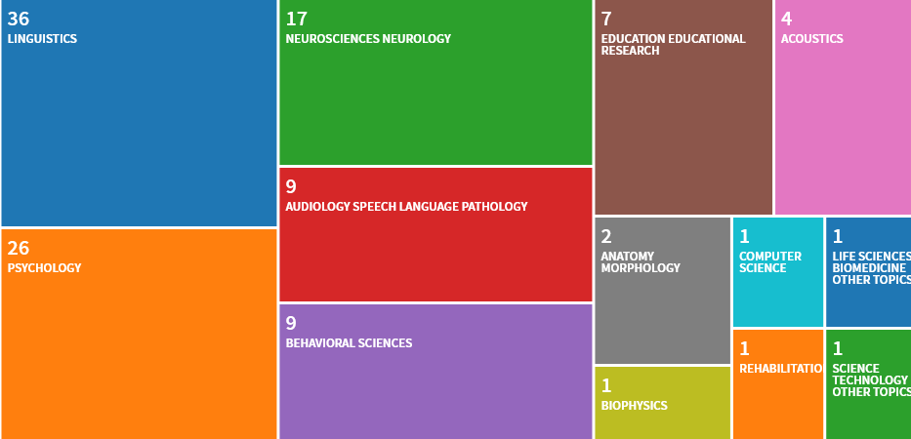
Who’s citing Isabelle Darcy? (n = 69)

Slide 3
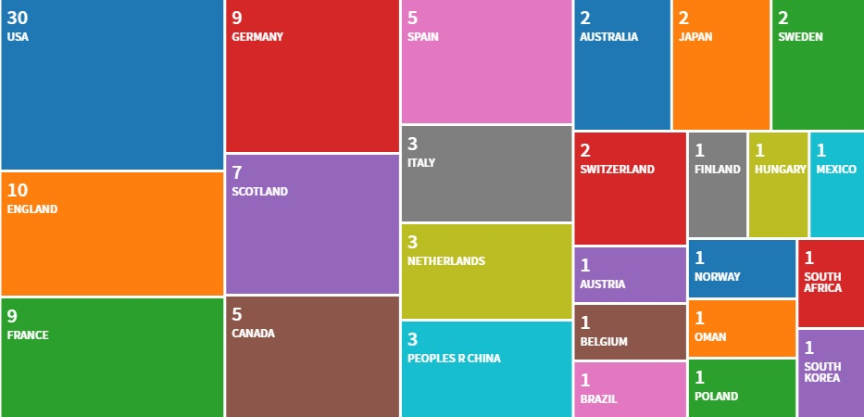
Who’s citing Isabelle Darcy? (n = 75)

Slide 4
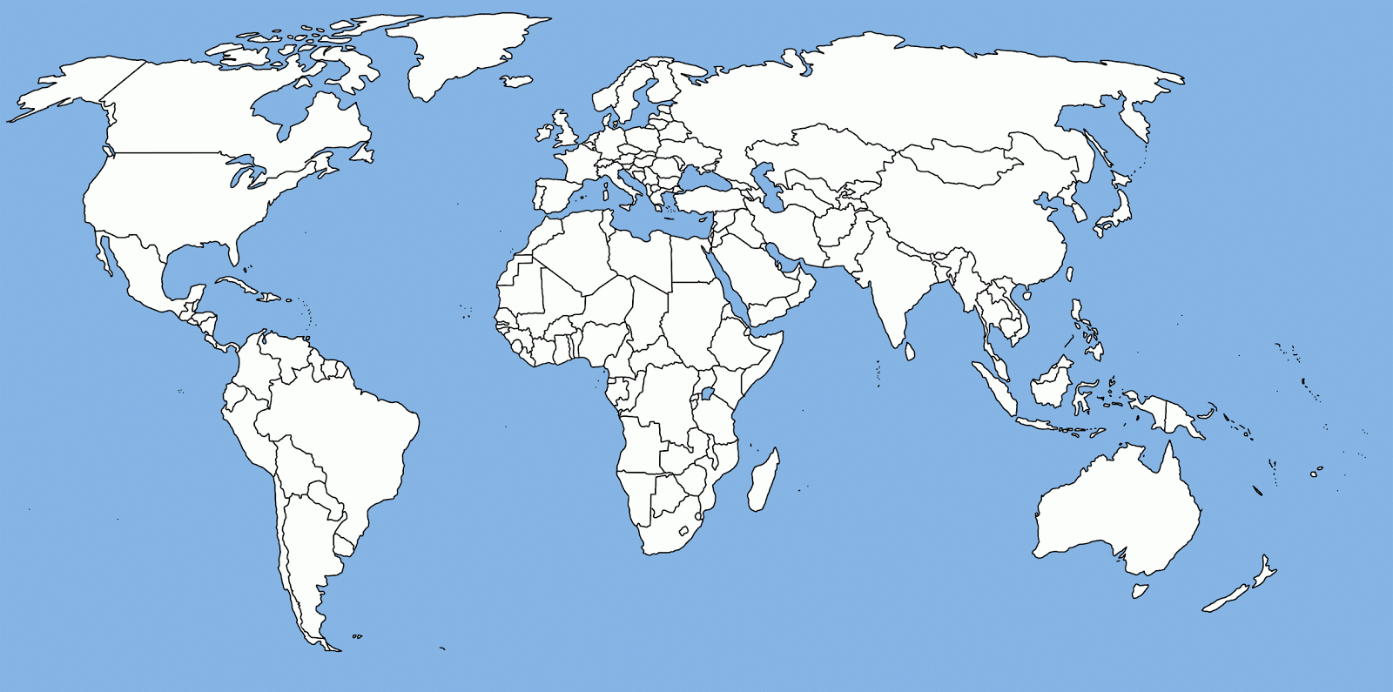
Solo Presentations by Isabelle

Slide 5
Presentations by IUSLPL Scholars

Slide 6
What is this number?
278
A. the total meters of Ethernet cable Isabelle has installed for free
B. Isabelle’s new office number in Morrison Hall
C. the room number for the IUSLPL in Weatherly Hall
D. number of conference posters/presentations by IUSLPL scholars

Slide 7
What is this number?
2023
A. the year Isabelle plans to retire to Bordeaux ['por.tu]
B. total languages on Ethnologue (= 4,090,506 L1-L2 pairings!)
C. the year all current lab members must defend by
D. estimate of total participants in all IUSLPL published research

Slide 8
L1s & L2s of IUSLPL Publications
L1
(12)
Afrikaans
Arabic
L2
(11)
Arabic
ASL
ASL
English
English
French
Japanese
German
Korean
Japanese
Mandarin
Korean
Portuguese
Mandarin
Russian
Russian
Spanish
Spanish
Thai
Thai
Turkish

Slide 9
What is this number?
112
A. minimum participant pool for reliable one-way ANOVA results
B. the IU course number for Introduction to SLS for undergrads
C. the number of MA and PhD committees Isabelle has been on
D. a conservative count of academic publications by IUSLPL scholars

Slide 10
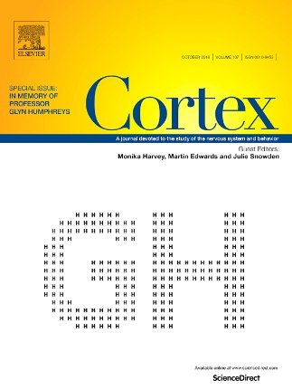
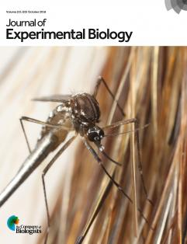
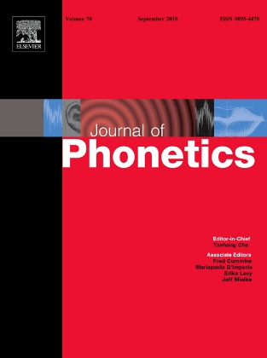
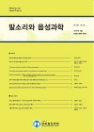
Where can I find articles by IUSLPL scholars?

